Slide 1
FCC3 246: CONCRETE MATERIALS
Lecture 1: INTRODUCTION AND COURSE OVERVIEW
Department of Civil & Construction Engineering
University of Nairobi
mwauras@uonbi.ac.ke

Slide 2
Lecturer details
Injinia Mwaura
University of Nairobi (Kenya)
Department of Civil & Construction Engineering
Faculty of Engineering
mwauras@uonbi.ac.ke
Tel: 0729 377 629

Slide 3

Housekeeping
Use your University email address
Coursework – 30% Main Exam – 70%
Coursework - 20% CAT / 10% Written Laboratory Report (Group)
Class attendance Compulsory at least 2/3 of all classes
Lecture Time: Mondays 9am - 11am
Lecture Time/Laboratory Time: Tuesday 9am - 11am

Slide 4
Course Purpose
This course will provide learners with knowledge on the manufacture process of cement, manufacture and properties of concrete, testing of concrete and durability
properties of concrete.

Slide 5
Expected Learning Outcomes
At the end of the course, a learner should be able to:
Understand the elements (components) and benefits of concrete
Understand the intricacies of the process of the manufacture of cement, including quality control of the manufacture process as well as the resulting environmental concerns.
Understand the process of manufacture of concrete, quality control of the process, testing of concrete and properties of both plastic and hardened concrete.
Understand durability aspects of hardened concrete including concrete thermal properties and corrosion of steel in concrete.

Slide 6
Course Content
Manufacture and properties of inorganic cements – Portland cement
Hydration of Portland cement
Rheology of fresh concrete – workability and segregation
Properties of hardened concrete – concrete compressive and tensile strengths, creep and shrinkage
Manufacture of concrete – ready mix concrete
Concrete mix design
Non-destructive testing of concrete
Durability of concrete -durability quality control of concrete, corrosion of steel in concrete, thermal properties of concrete, effects of fire on concrete
Materials Laboratory

Slide 7
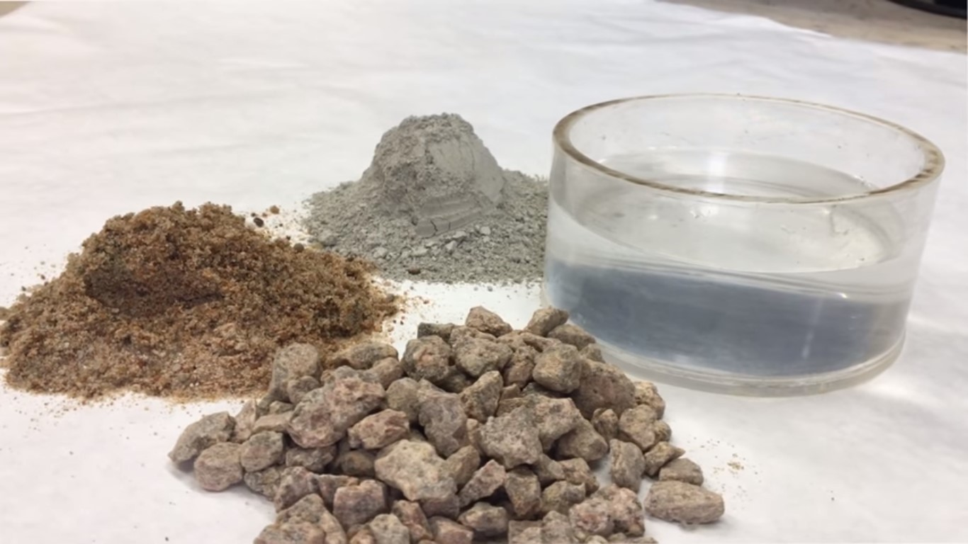
FUNDAMENTAL PRINCIPLE
CONCRETE = CEMENT + AGGREGATE + WATER
CONCRETE = CEMENT + FINE AGGREGATE (Sand) + COARSE AGGREGATE (Ballast) + WATER

Slide 8
Key Processes in the Manufacture and Application of Concrete
Batching - Proportioning the key ingredients of concrete whose proportions determine the final hardened concrete strength. It is more accurate to batch by weight than by volume
Mixing - To achieve homogeneity, consistency and uniformity; By hand using shovels or using concrete mixers
Transportation - Moving concrete from point of production to where it will be placed. Transportation is by use of buckets; wheel-barrows; piping; cranes; tankers with rotating containment for agitation of wet concrete to prevent it setting before it is placed etc
Placing - Putting concrete in formwork where it will finally rest permanently to form a structural component that provide structural strength against applied loads and forces
Compaction - Consolidation of concrete to achieve maximum density through removal of voids in wet concrete using tamping rods, vibrators etc to attain maximum strength
Curing - Maintaining wet surfaces on placed concrete for continued hydration of cement in the concrete for achievement of desired concrete strength. This is done by sprinkling water, using wet gunny bags, ponding etc

Slide 9
THE END
LECTURE ONE

